Slide 1
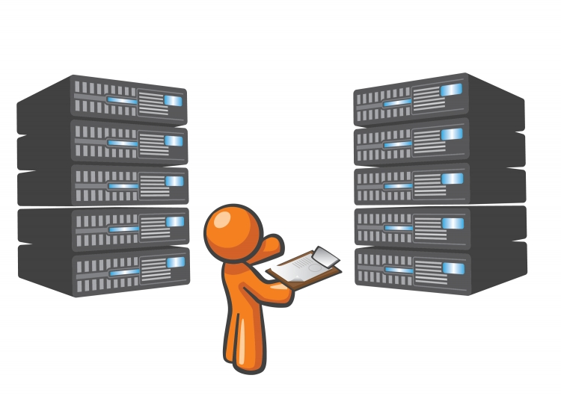
SEGES – Drift overvågning

Slide 2

Agenda
ETL DWH drift rapport
SQL tests
SSRS rapport
Mail trigger
Azure ETL
Runbook job status
Log Analytics (Azure Monitor)
Mail alert

Slide 3

Spørgsmål

